Slide 1
Set

Slide 2
•A set in Python holds a sequence of values.
•It does not support indexing.
•It may contain values of different data types.
•An interpreter may sorted the element of a set in ascending order.
•A Set may allow random assignment of elements.

Slide 3



Creating a Set
We need to type a sequence of items separated by commas, inside curly braces.
A set also can not contain duplicate elements.

Slide 4
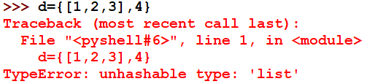
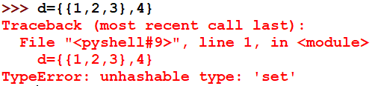

Creating a Set
A set is mutable, but may not contain mutable items like a list, set, or even a dictionary.
A set can allow immutable items like tuple.

Slide 5

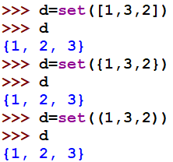
Creating a Set
We can also create a set with the set() function.
This function creates a set object.

Slide 6
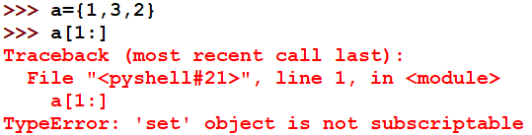
Accessing a Set
Set do not support indexing.
it is only possible to access the entire set at once.
Therefore we can not perform slice operation using slice operator.

Slide 7



Deleting a Set
We can not delete an element using its index.
For this, we use following methods:
discard(): This method takes the item to delete as an argument.
remove(): It deletes an item from the set.

Slide 8

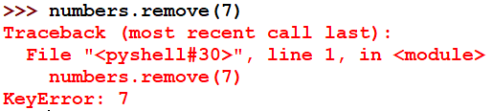
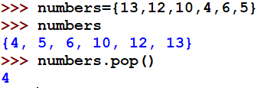

Deleting a Set
discard() vs remove(): If we try to delete an item that doesn’t exist in the set, discard() ignores it, but remove() raises a Key error.
iii) pop():

Slide 9
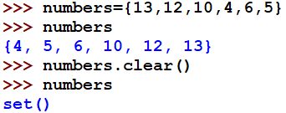
Deleting a Set
clear(): It empties the set in Python.

Slide 10
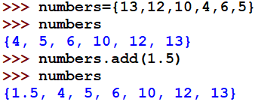
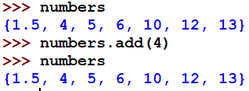
Updating a Set
We use two methods for this purpose: i) add() and ii) update().
add(): It takes as argument the item to be added to the set.
If we add an existing item in the set, the set remains unaffected.

Slide 11


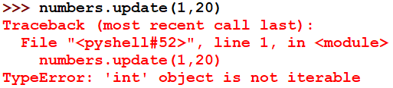
Updating a Set
ii) update(): This method can add multiple items to the set at once.

Slide 12



Functions on Sets
len(): It returns the length of a set.
max(): It returns the item from the set with the highest value.
min(): It returns the item in the Python set with the lowest value.

Slide 13

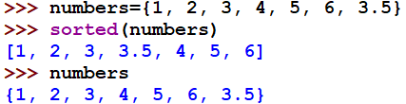
Functions on Sets
sum(): It returns the arithmetic sum of all the items in a set.
any(): It returns True even if one item in the set has a Boolean value of True.
all(): It returns True only if all items in the Python set have a Boolean value of True.
sorted(): It returns a sorted python set to list. It is sorted in ascending order, but it doesn’t modify the original set.

Slide 14
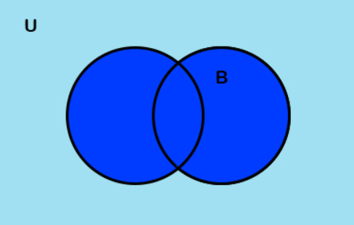
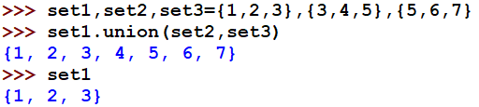
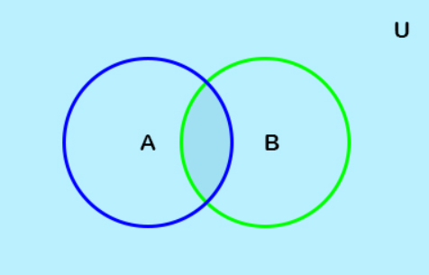

Methods
union(): It returns all the items that are in any of those sets. it did not alter individual set.
intersection(): It takes as argument sets, and returns the common items in all the sets.

Slide 15
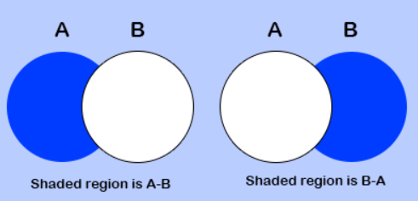
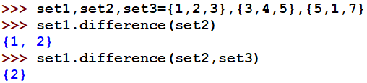
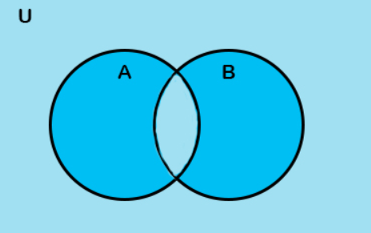

Methods
difference(): It returns the difference of two or more sets. It returns as a set.
symmetric_difference(): It returns all the items that are unique to each set.

Slide 16
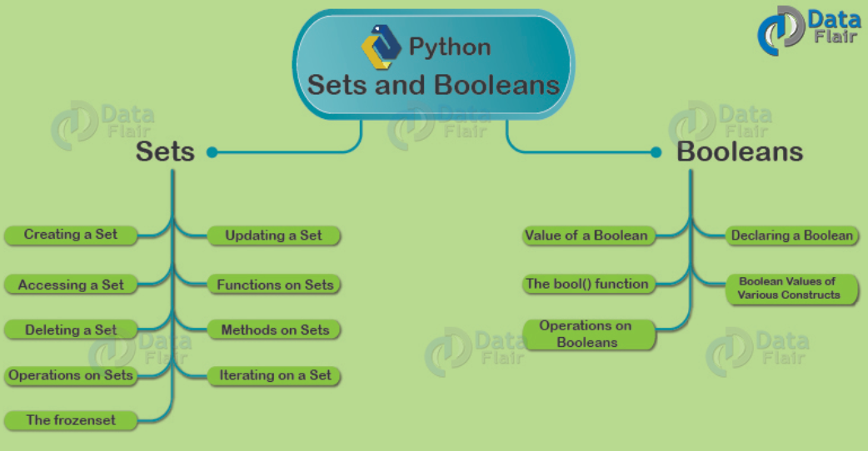

Slide 17


Methods
intersection_update(): It updates the set on which it is called.
difference_update(): It updates the set with the difference.

Slide 18


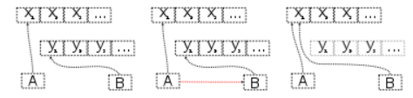
Methods
symmetric_difference_update(): it updates the set on which it is called with the symmetric difference.
copy(): It creates a shallow copy of the set.

Slide 19

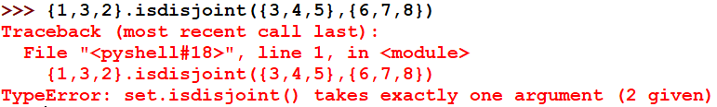
Methods
isdisjoint(): It returns True if two sets have a null intersection.
However, it can take only one argument.

Slide 20


Methods
issubset(): It returns true if the set in the argument contains this set.
issuperset(): returns True if the set contains the set in the argument.

Slide 21
Operation on set
Membership: ‘in’ and ‘not in’

